Slide 1
Hypoxia and the abundance, vertical distribution, and mortality of Acartia tonsa

Slide 2
How to define hypoxia?
North and South stations?
< 2 mg/L occupying more than a certain amount of water column?
More biologically relevant definition?

Slide 3
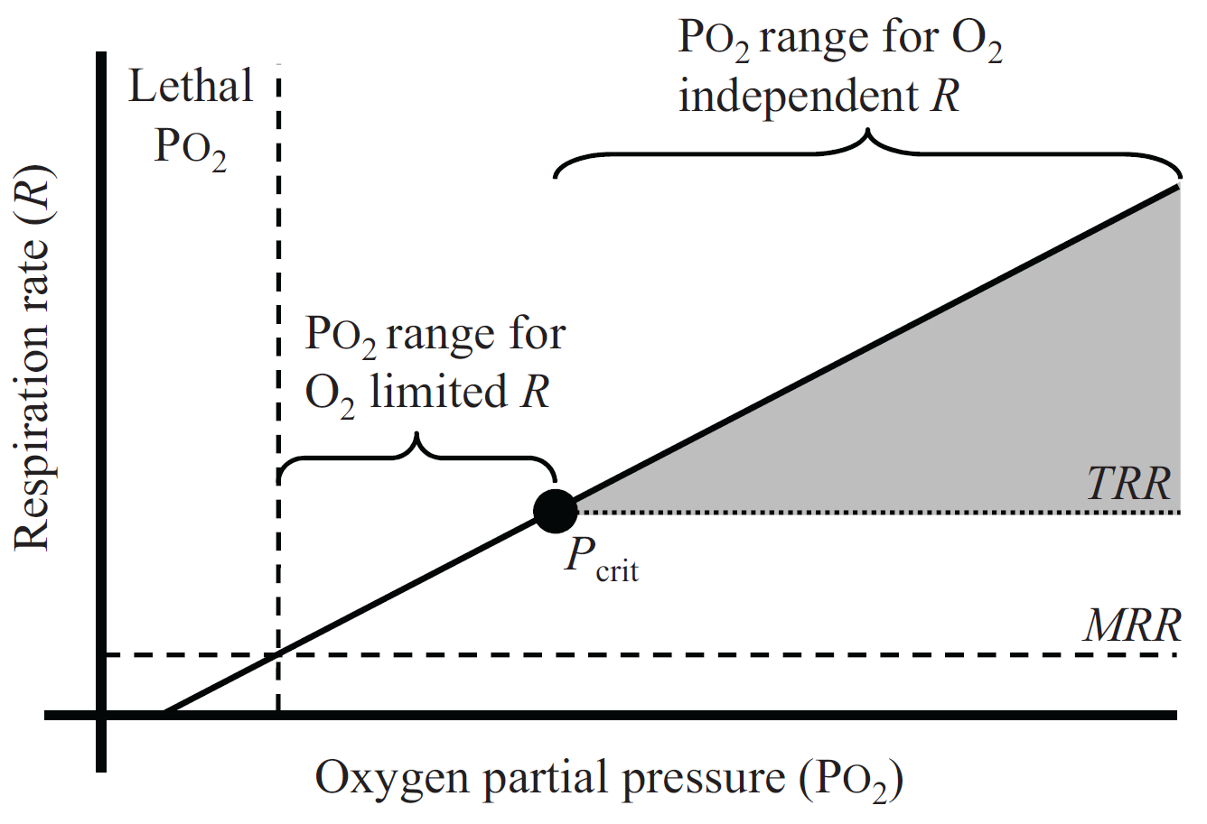
Relationship between water O₂ and respiration rate

Slide 4
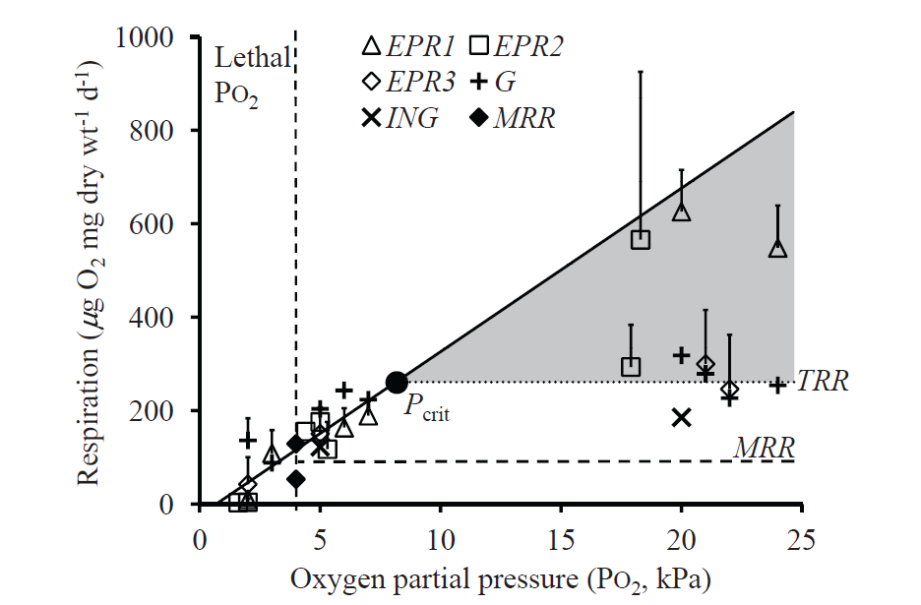
Relationship between water O₂ and respiration rate

Slide 5
Relationship between water O₂ and respiration rate
Used to derive equations predicting detrimental and lethal oxygen thresholds based on temperature and salinity

Slide 6
Methods
30 L collected at 3 depths
6 profiles each cruise
30 profiles total
Depth
O₂

Slide 7
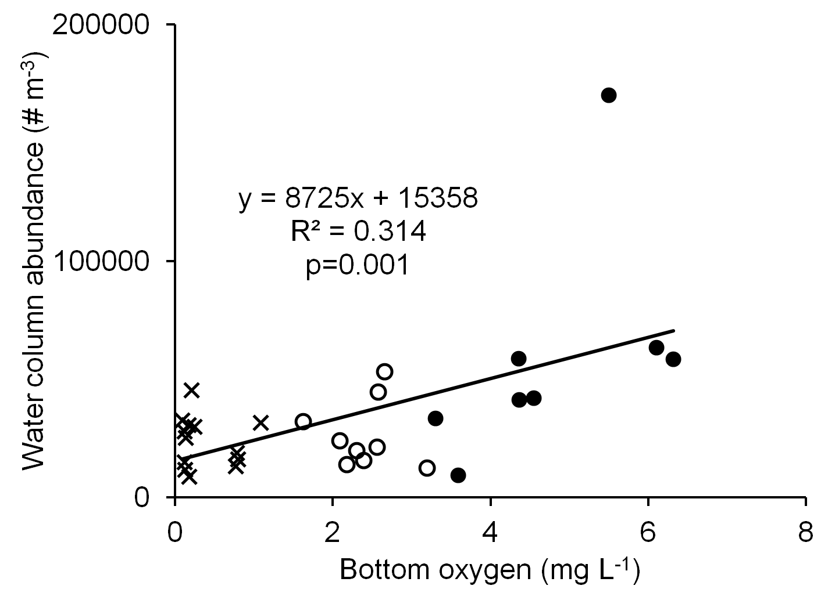
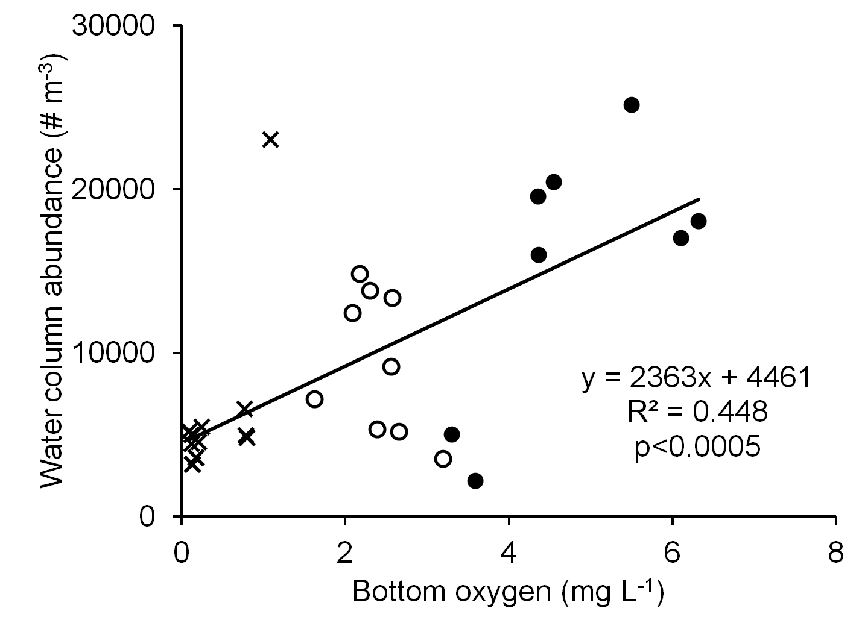
Hypoxia and abundance: Does abundance decrease throughout water column with decreasing O₂?
nauplii
copepodites

Slide 8
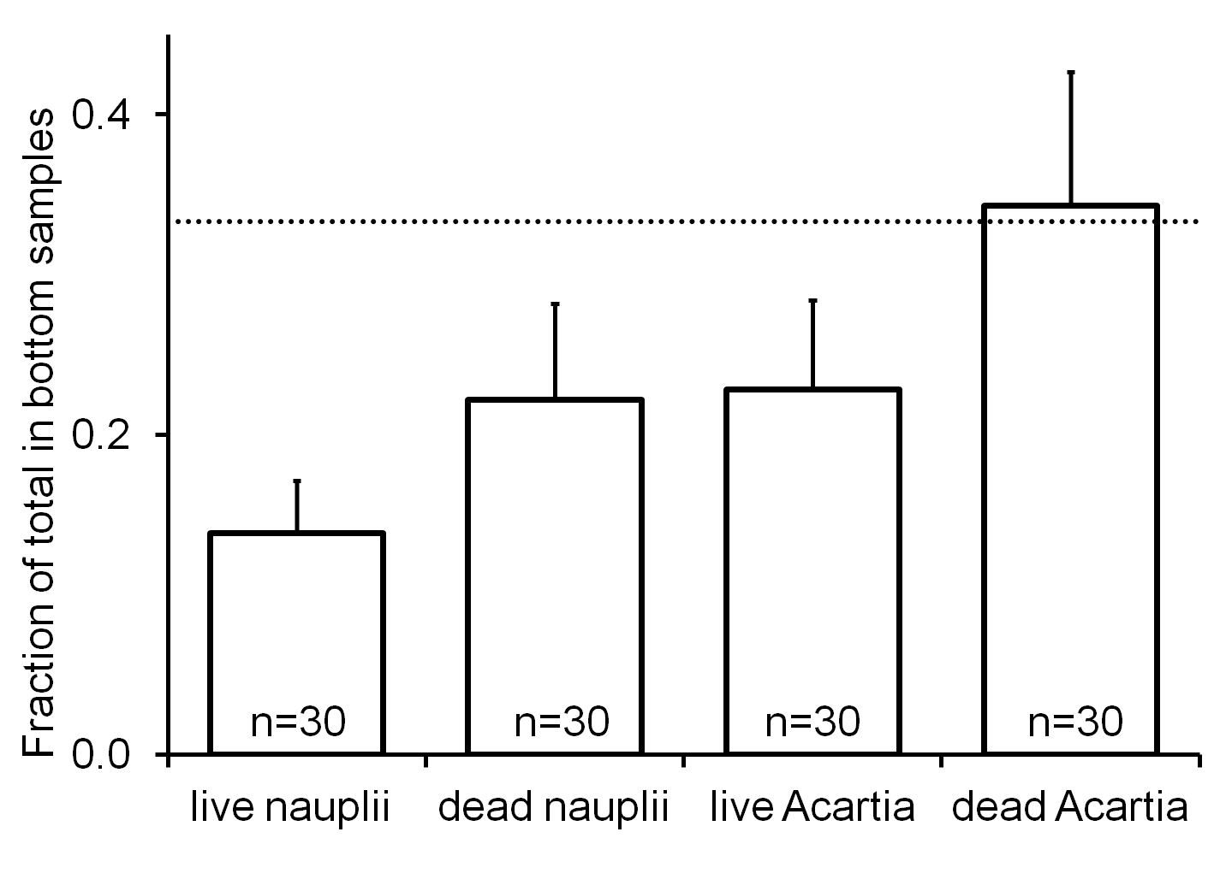
Vertical distribution of live & dead: Do distributions of live & dead differ?

Slide 9
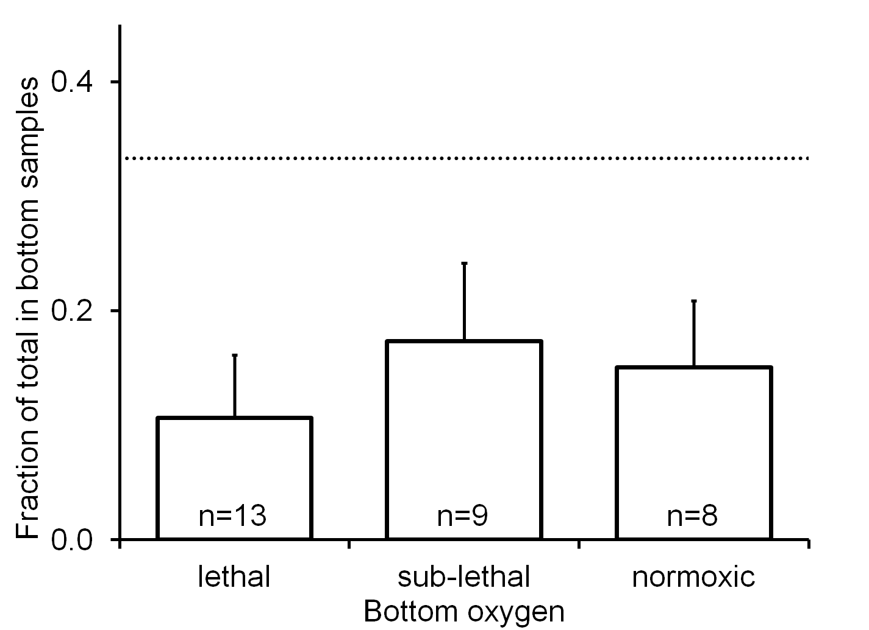
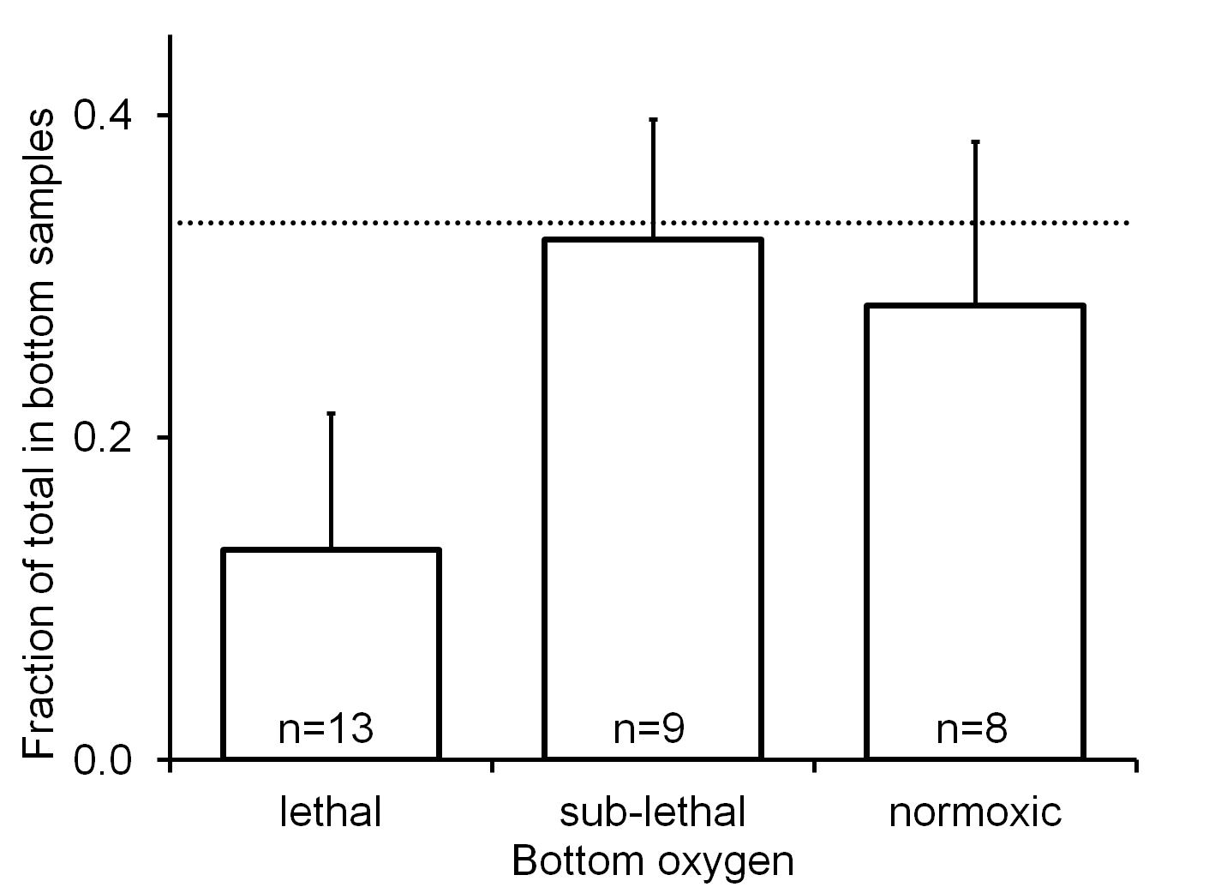
Hypoxia and live vertical distribution: Avoid bottom layer when hypoxic?
nauplii
copepodites

Slide 10
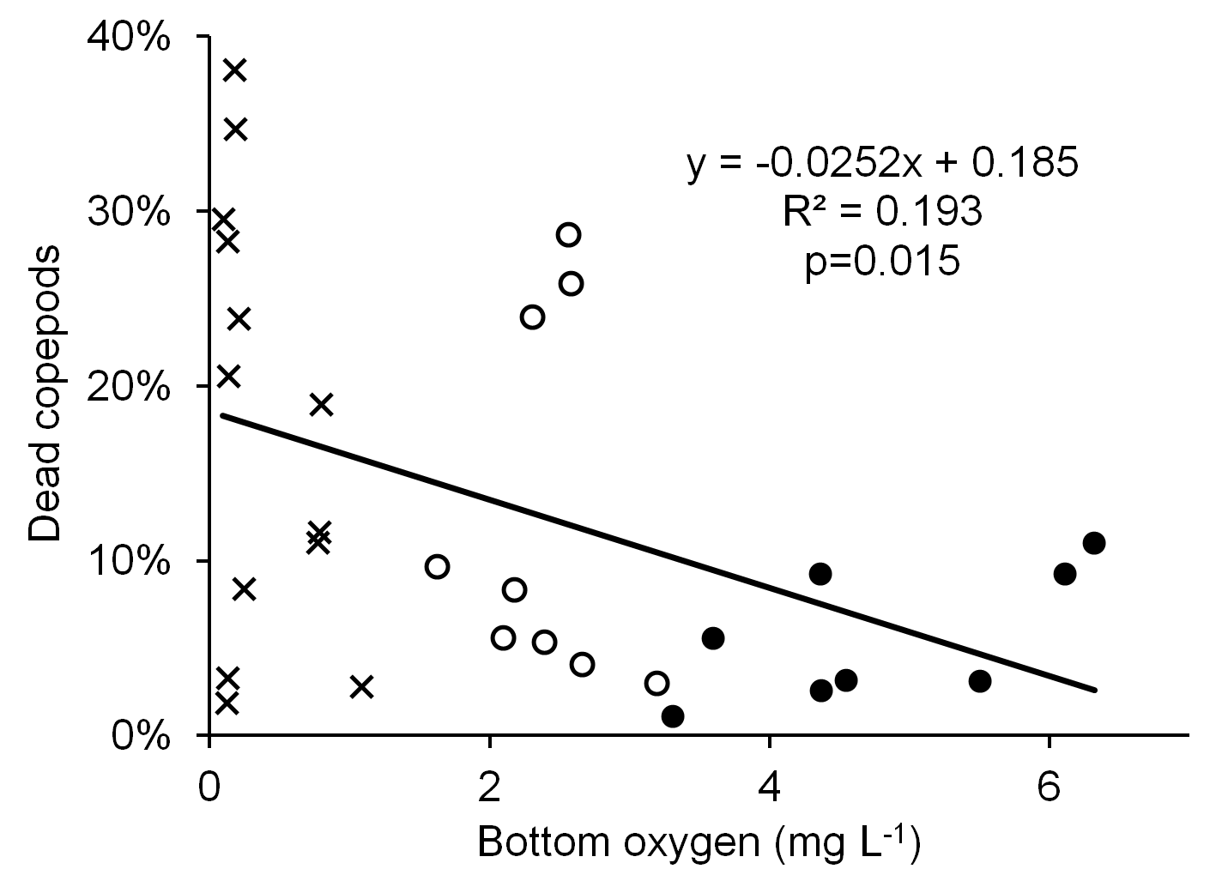
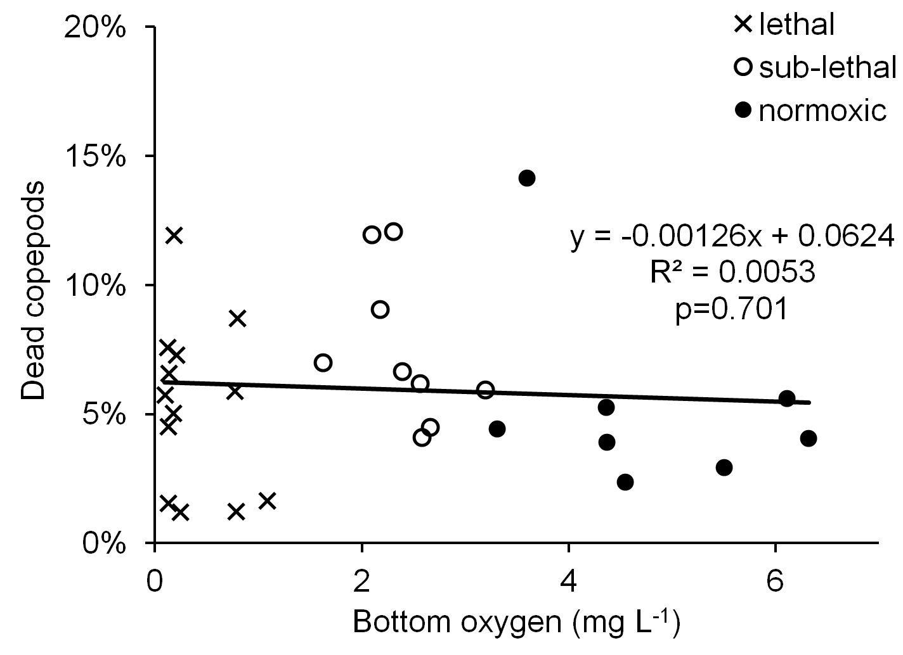
Hypoxia & mortality: Higher % dead throughout water column when bottom layer hypoxic?
nauplii
copepodites

Slide 11
Conclusions forthcoming…

